Slide 1
Vehicle Rental System (Velorent)
Project By:
Swosti Makaju
Thomas Bhattarai

Slide 2
Contents
Introduction
Problem Statement
Objectives
Scope of System
Literature Review
Requirement Analysis
System Design
Alogorithm Used
Project Timeline
Technology Used
Test Cases
Conclusion
Future Recommendations
References

Slide 3
Introduction
• A vehicle rental system is a digital platform designed to manage vehicle hiring.
• It offers flexible and convenient transportation options.
• Velorent automates booking, availability, and payments.

Slide 4
Problem Statement
Traditional rental systems rely on manual processes.
Customers lack real-time vehicle availability.
Admins struggle with efficient record management.
An automated system improves accuracy and efficiency.

Slide 5
Objectives
Develop an efficient online vehicle rental system.
Enable easy vehicle booking and management.
Provide real-time vehicle availability.

Slide 6
Scope of System
Online vehicle booking and reservation.
User registration, login, and profile management.
Vehicle listing with price, type, and availability.
Admin management of vehicles, users, and bookings.
Secure payment and booking history

Slide 7
Literature Review
The vehicle rental market is growing due to demand for flexible, cost-effective transportation driven by urbanization and tourism. [1]
VeloRent positions itself as a modern, customer-focused platform to remain competitive and enhance user satisfaction. [2]
Peer-to-peer rental platforms are reshaping the industry through community trust and transparent practices. [3]

Slide 8
Requirement Analysis
Functional Requirements
User registration and secure login.
Browse and search available vehicles.
Vehicle booking with date and duration selection
Online payment and booking confirmation.
Admin management of vehicles and bookings.
Non-Functional Requirements
Fast response time.
Secure data storage and encryption.
High system reliability and availability.
Scalability for future growth.

Slide 9
System Design
• Use Case Diagram
• ER Diagram
• DFD(Data Flow Diagram)
• Database Schema

Slide 10
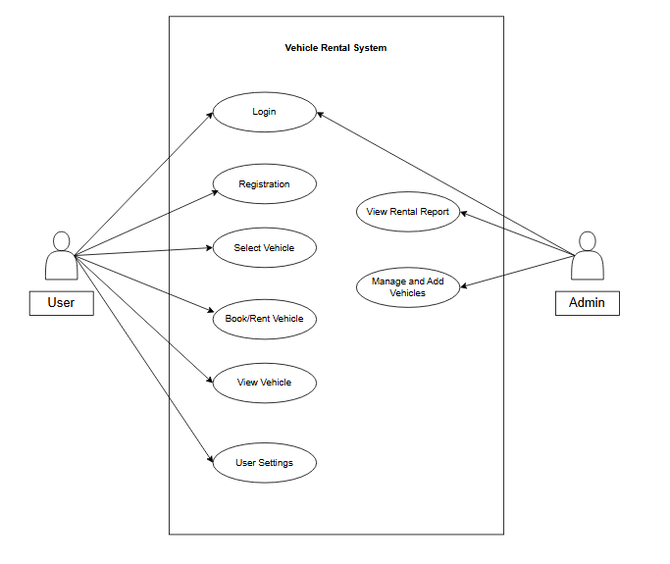
Use Case Diagram

Slide 11
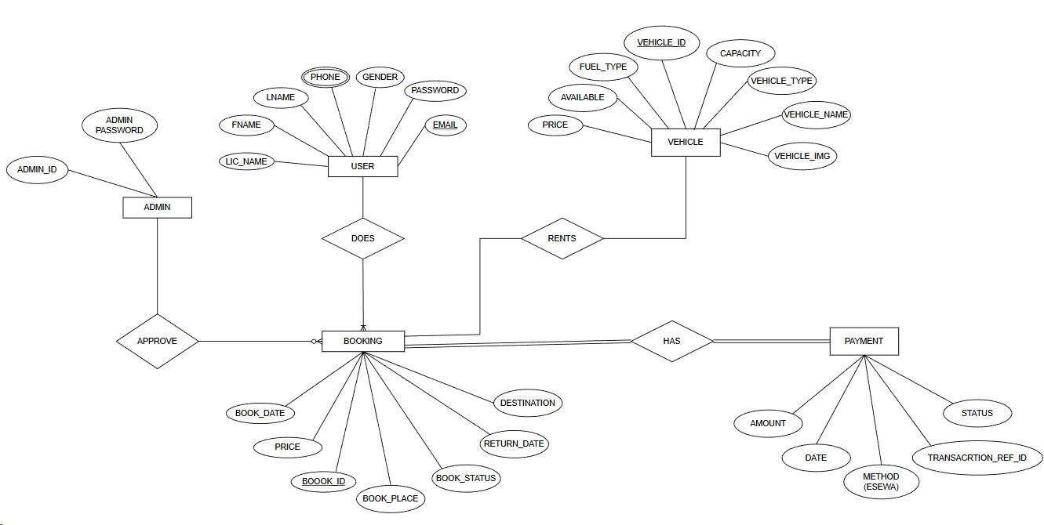
ER Diagram

Slide 12
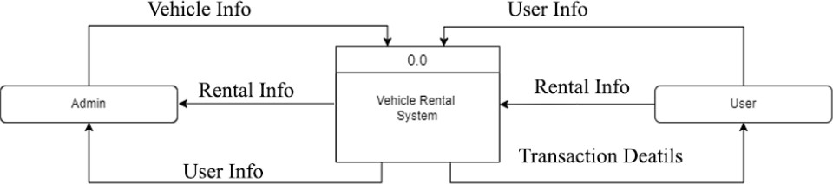
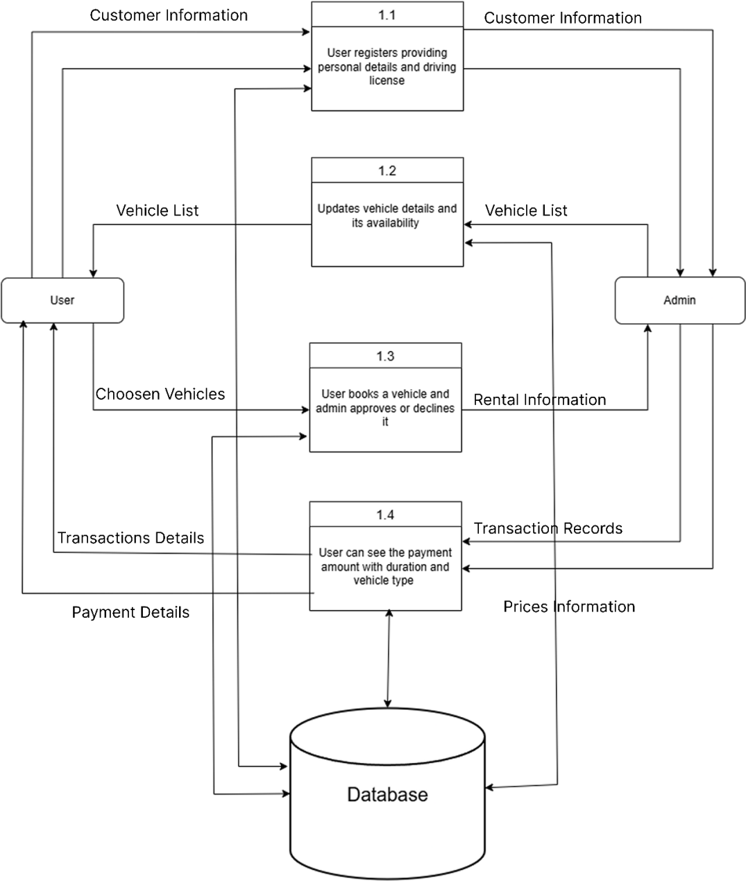
DFD (Data Flow Diagram)
Figure : Level 0 DFDof Vehicle Rental System
Figure : Level 1 DFD of Vehicle Rental System

Slide 13
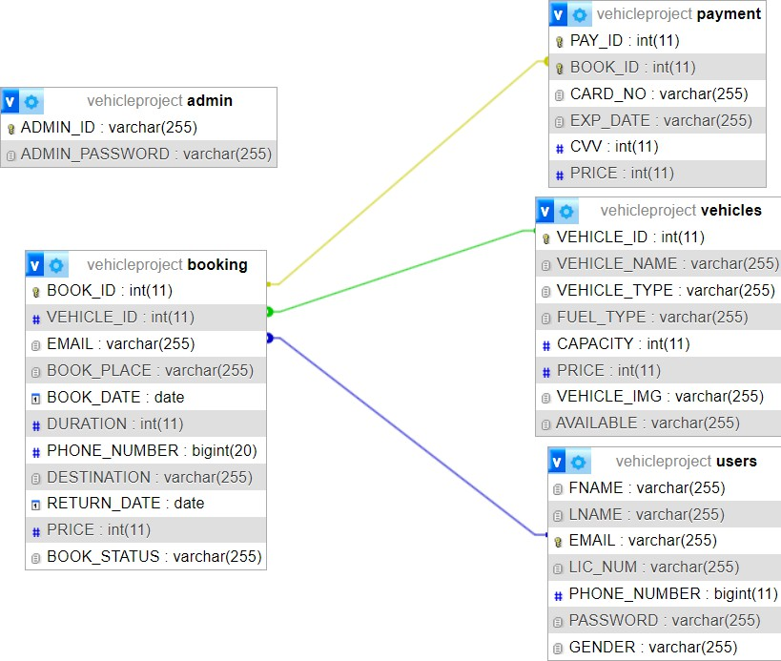
Database Schema

Slide 14
Algorithms Used
Recommendation Algorithm: Suggests vehicles based on other user past booking, ratings, reviews, and popularity.
These algorithms improve usability and help users make better decisions quickly.

Slide 15
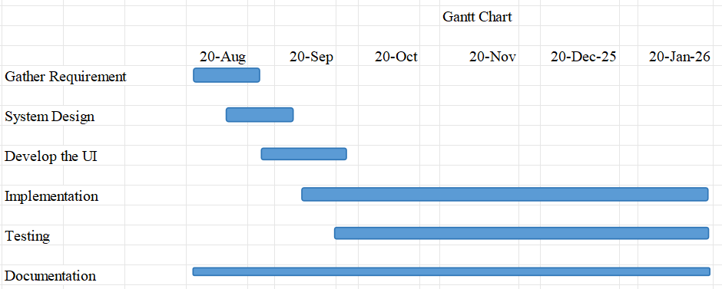
Gantt Chart
 | Documentation | Testing | Implementation | Develop the UI | System Design | Gather requirement
Start Date | 20 Aug | 16 Oct | 25 Sep | 12 Sep | 1 Sep | 20 Aug
Duration (In days) | 154 | 35 | 90 | 23 | 24 | 12

Slide 16
Technology Used
Frontend: HTML, CSS, JavaScript
Backend: PHP
Database: MySQL
Server: XAMPP
Design Tools: Figma, Draw.io

Slide 17
Test Cases (Unit Testing)
Module | Key Tests | Result
User Registration | Field validation, email & password rules, duplicates | Passed
User Login | Empty fields, invalid & valid login | Passed
Password Reset | Email verification & reset | Passed
Admin Login | Credential validation & access control | Passed
Logout | Session destroy & redirect | Passed

Slide 18
Test Cases (System Testing)
Module | Key Tests | Result
Authentication | User/Admin login & logout | Passed
User Management | User registration, profile update, view user details | Passed
Vehicle Management | Add, update, view, delete vehicle details | Passed
Vehicle Search & Filter | Search vehicle, filter by type and availability | Passed
Booking Management | Create booking, view booking history, cancel booking | Passed
Payment System | Booking validation, eSewa payment success/failure | Passed
Admin Panel | Manage users, vehicles, bookings, payments | Passed
Reports & Records | View booking records and transaction history | Passed
Security | Session validation, access control | Passed

Slide 19
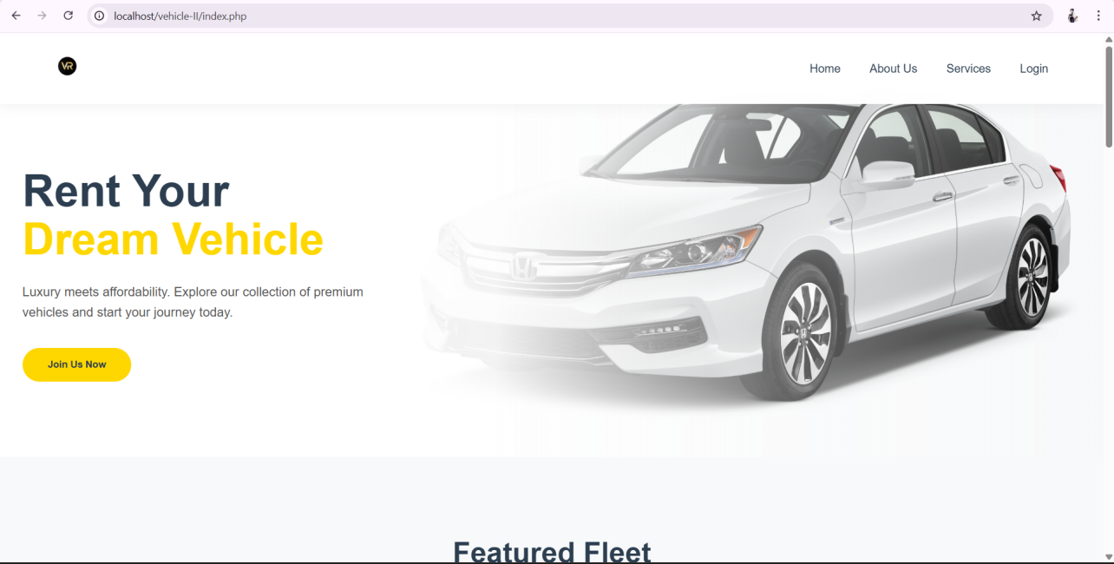
Home Page

Slide 20
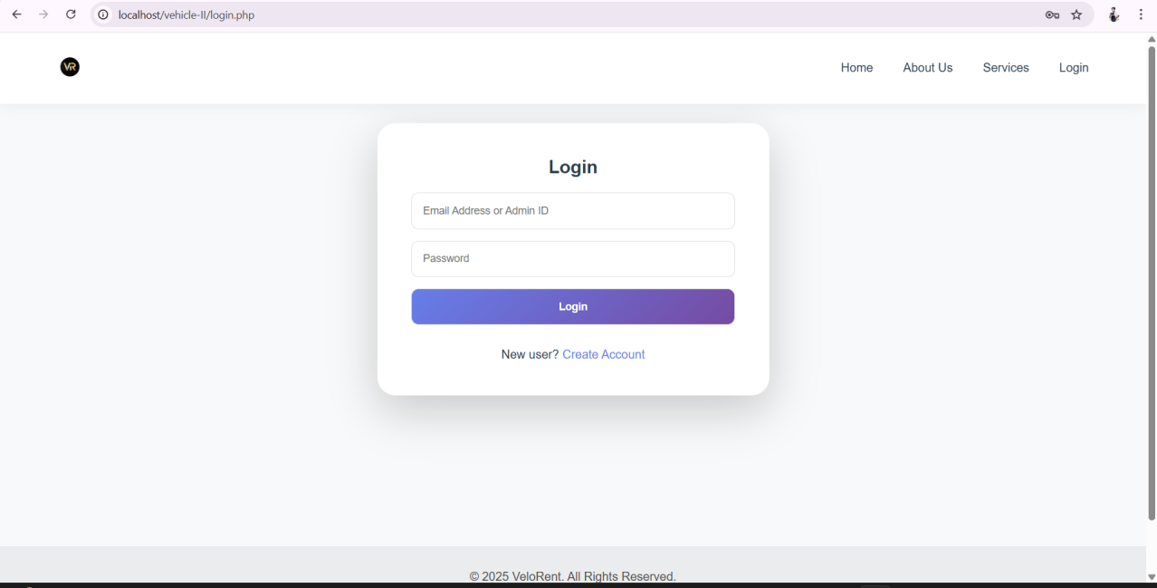
Admin Login

Slide 21
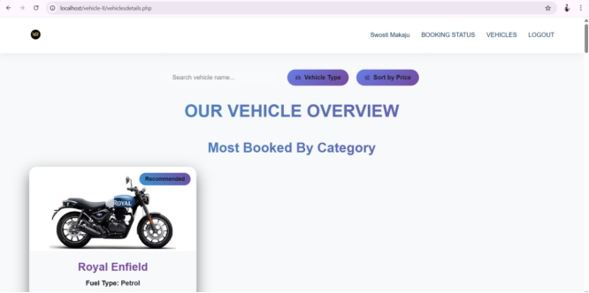

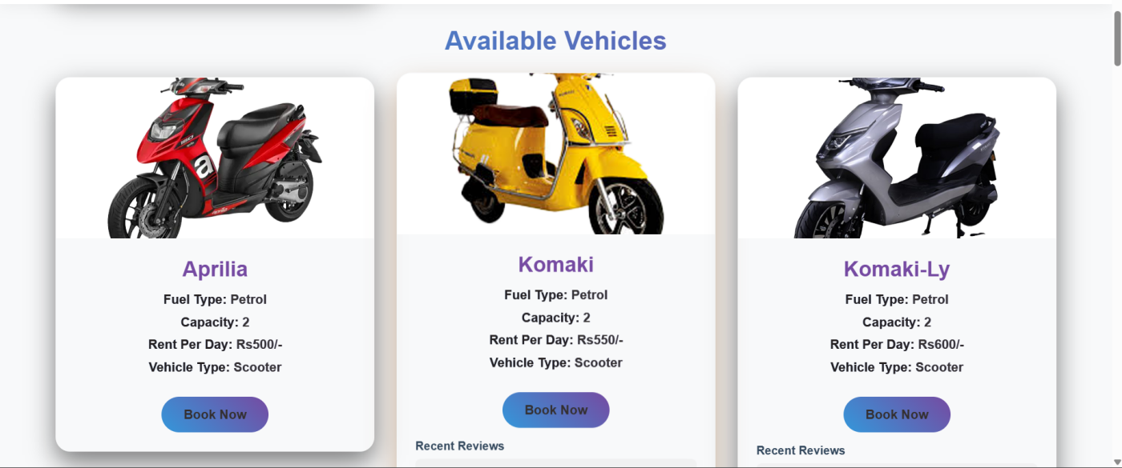
User Dashboard

Slide 22
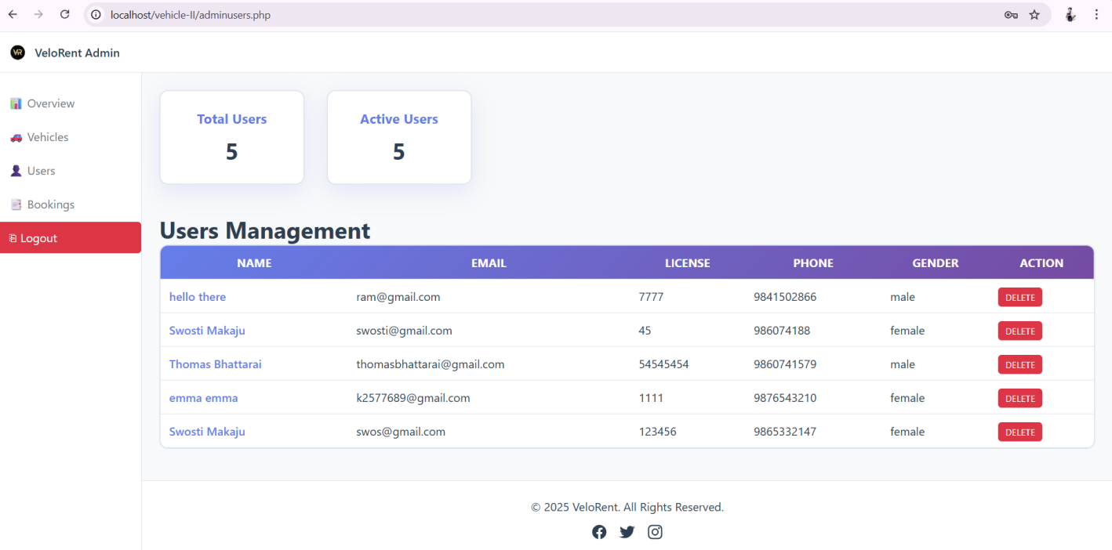
User Details

Slide 23
Conclusion
The Vehicle Rental System successfully automates rental operations.
It improves efficiency, accuracy, and customer satisfaction. The system reduces manual work and ensures secure data handling.
All project objectives were achieved successfully.

Slide 24
Future Recommendations
• AI-based recommendations
• Chatbot support
• Advanced analytics
• Scalable server deployment

Slide 25
References
[1] | K.Acharya,"Research Gate," [Online]. Available: https://www.researchgate.net/publication/380835687_Online_Vehicle_Rental_Syste m_Project_Report.
[2] | "Types of Feasibility Study in software project deavelopmeint," GeeksforGeeks, [Online]. Available: https://en.wikipedia.org/wiki/MySQL. [Accessed 05 September 2024].
[3] | W3Schools, "W3Schools," [Online]. Available: https://www.w3schools.com/html/. [Accessed 20 August 2024].
[4] | "Tutorials Point," [Online]. Available: www.tutorialspoint.com/javascript/index.html. [Accessed 28 08 2024].
[5] | R. E. Shamkanth, in Fundamental Of Database System, Pearson.
[6] | A. Forbes, "The Joy of PHP Programming," Plum Island.
[7] | "Wikipedia," Wikipedia, [Online]. Available: https://en.wikipedia.org/wiki/MySQL. [Accessed 30 August 2024].

Slide 26
Thank You

